Slide 1

Spring 2023
CSE 427 (Digital Image Processing)
Topic - 2: Image Fundamentals
Course Teacher:
Naznin Sultana
Associate Professor
Department of Computer Science and Engineering
Daffodil International University

Slide 2
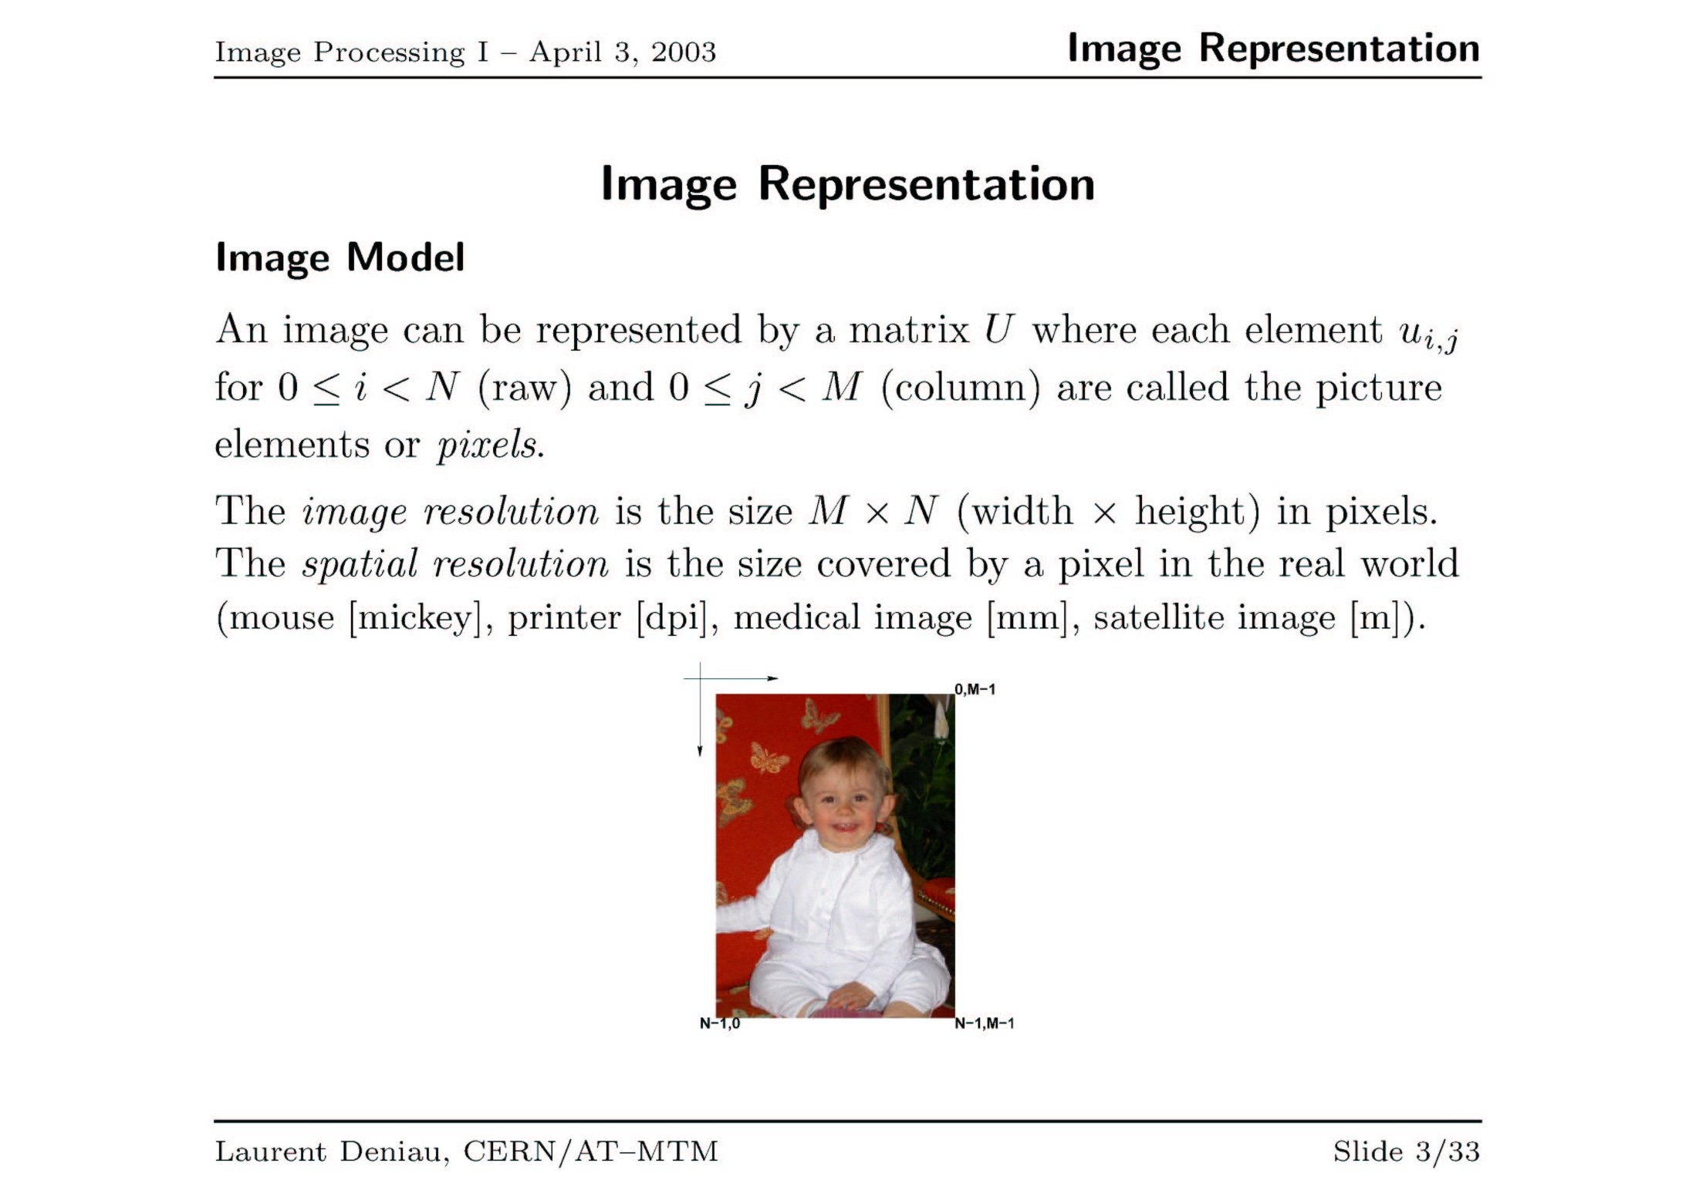
Dr. M. S. Uddin, CSE Dept, JU

Slide 3
Simple Image Representation
0
(width-1)
Represent an image as a 2D array.
Indices represent the spatial location
Values represent light intensity
0
Picture Element (pixel)
(height-1)
Dr. M. S. Uddin, CSE Dept, JU

Slide 4
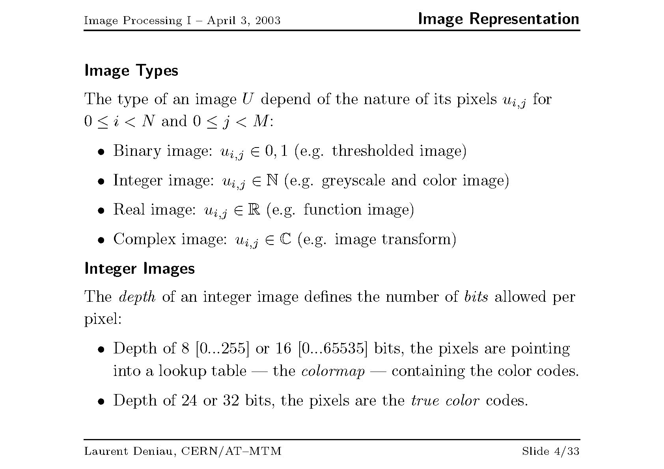
Dr. M. S. Uddin, CSE Dept, JU

Slide 5
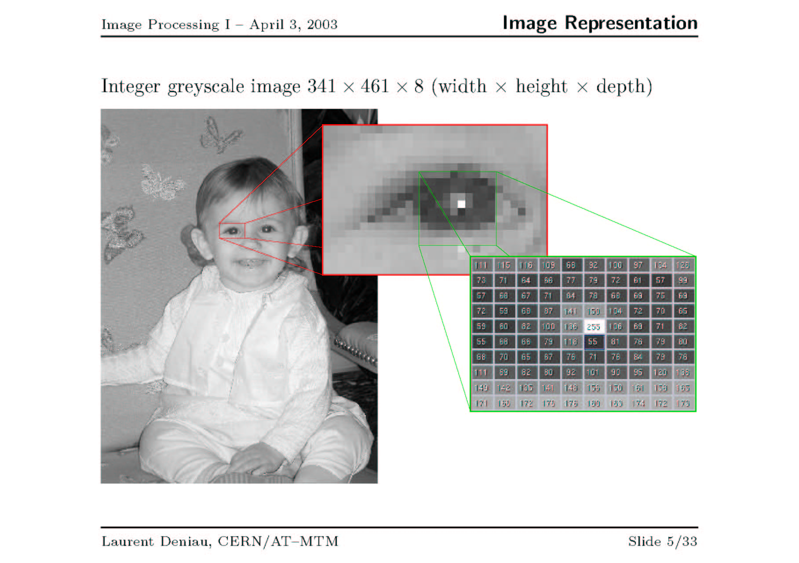
Dr. M. S. Uddin, CSE Dept, JU

Slide 6



Sinusoidal Image Generation
Image size = (width × height) = (M × N) = (128 × 64) pixels
Dr. M. S. Uddin, CSE Dept, JU

Slide 7
Imaging
Imaging means “image acquisition”
The process of sensing our surroundings and then representing the measurements that are made in the form of an image
Dr. M. S. Uddin, CSE Dept, JU

Slide 8
Active and Passive Imaging
Imaging can be active or passive
  Passive: No external source is required. Uses the energy sources already present in the scene.
    Cameras without a flash
    Night vision goggle
  Active: External source is required.
    MRI
    X-Rays
    Radar
    Scanner
    Cameras with a flash
Dr. M. S. Uddin, CSE Dept, JU

Slide 9
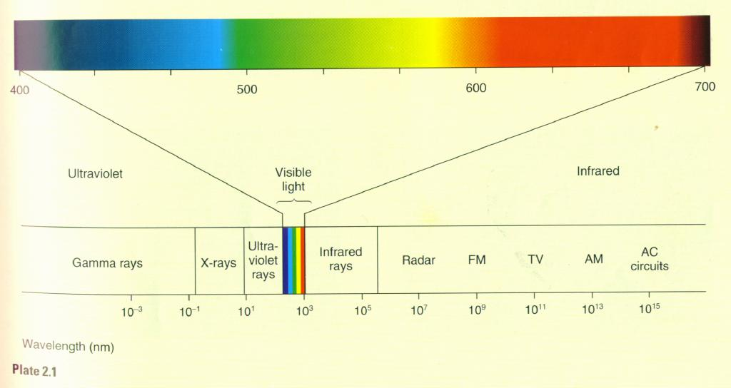
Electromagnetic Radiation Spectrum
Source: http://zeus.rutgers.edu/~ikovacs/SandP/Perception.html
Dr. M. S. Uddin, CSE Dept, JU

Slide 10
Visible Spectrum
Light is a good source for imaging
  Light is familiar
  Light is safe
  Light can be generated economically and reliably
  Light is easy to process with optical hardware
  Light is easily detected
Dr. M. S. Uddin, CSE Dept, JU

Slide 11

Camera Optics
f
D₀
D₁
1/f = 1/D₀ + 1/ D₁
Magnification = ImageSize/ObjectSize
Magnification = D_{1/} D₀
As an object moves closer (than infinity) it focuses “behind” the focal point distance.
Dr. M. S. Uddin, CSE Dept, JU

Slide 12
Sampling and Quantization Example
Problem: Sample a 1D continuous function (usually of time)
f(t)
Quantization (how accurately can a signal be measured)
t
Sampling rate (how often is a signal measured)
Dr. M. S. Uddin, CSE Dept, JU

Slide 13
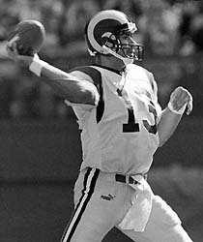


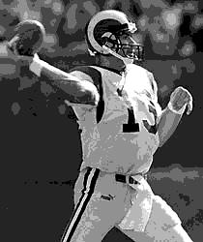
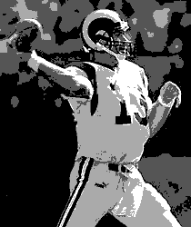
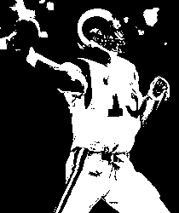
Effect of Quantization
A | B | C
D | E | F
Number of Gray Levels
A: 256
B: 32
C: 16
D: 8
E: 4
F: 2
Each image is 210 x 250
Dr. M. S. Uddin, CSE Dept, JU

Slide 14
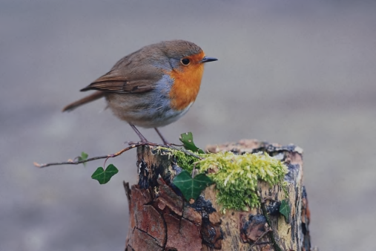
Image Coordinate System
Coordinate system is conventionally defined as:
(0,0)
x
y
Dr. M. S. Uddin, CSE Dept, JU

Slide 15
Image File Formats
Typical format involves a header followed by the pixel data
Magic Number
Header
Pixel Data (in some format … perhaps compressed)
Magic Number – a unique identifier that identifies the file format
Header – miscellaneous information about the image. Image size, palette, compression method, etc…
Data – the pixel data in some format
Dr. M. S. Uddin, CSE Dept, JU

Slide 16
Image File Formats
Typical format involves a header followed by the pixel data
Magic Number
Header
Pixel Data (in some format … perhaps compressed)
PNG | OxD3PNG
GIF | GIF89a
JPEG | OxFFD8FFE0JFIF\0
PPM ASCI | P3
Dr. M. S. Uddin, CSE Dept, JU

Slide 17
Image File Formats
BMP – Windows Bitmap
MacPaint – Macintosh format
PPM – (PBM, PGM, PPM)
GIF – Unisys owned format
PNG – Generic replacement for GIF
JFIF - JPEG
FITS – Flexible Image Transport System
Dr. M. S. Uddin, CSE Dept, JU

Slide 18
PBM, PGM, PPM
These formats are simple and easy to encode/decode. The ASCII variants are ideal for image transmission.
Magic Number | Image Type | Storage
P1 | binary | ASCII
P2 | grayscale | ASCII
P3 | RGB | ASCII
P4 | binary | native
P5 | grayscale | native
P6 | RGB | native
Dr. M. S. Uddin, CSE Dept, JU

Slide 19
PGM ASCII Format
magic number
P2
# small little image
7 7 255
120 120 120 120 120 120 120
120 120 120 33 120 120 120
120 120 120 33 120 120 120
120 33 33 33 33 33 120
120 120 120 33 120 120 120
120 120 120 33 120 120 120
120 120 120 120 120 120 120
comment
width height max_value
pixel values
Dr. M. S. Uddin, CSE Dept, JU

Slide 20
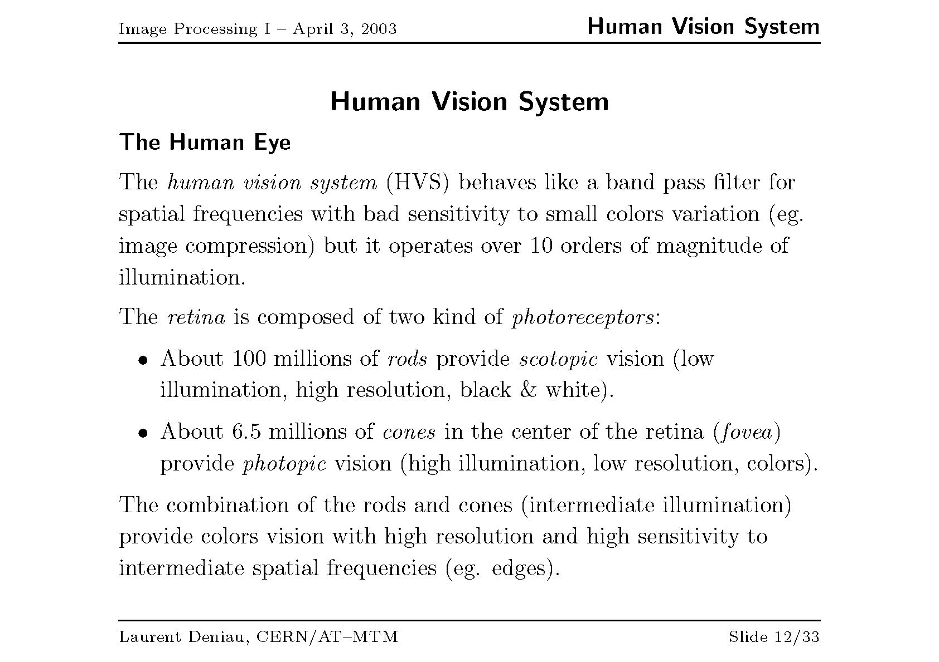
Dr. M. S. Uddin, CSE Dept, JU

Slide 21
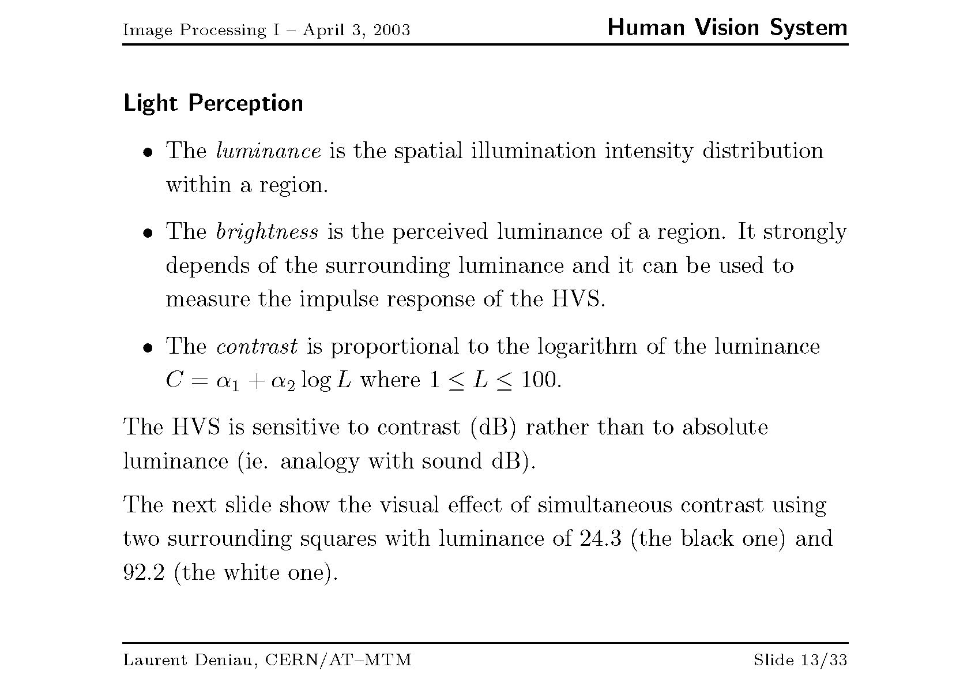
Dr. M. S. Uddin, CSE Dept, JU

Slide 22
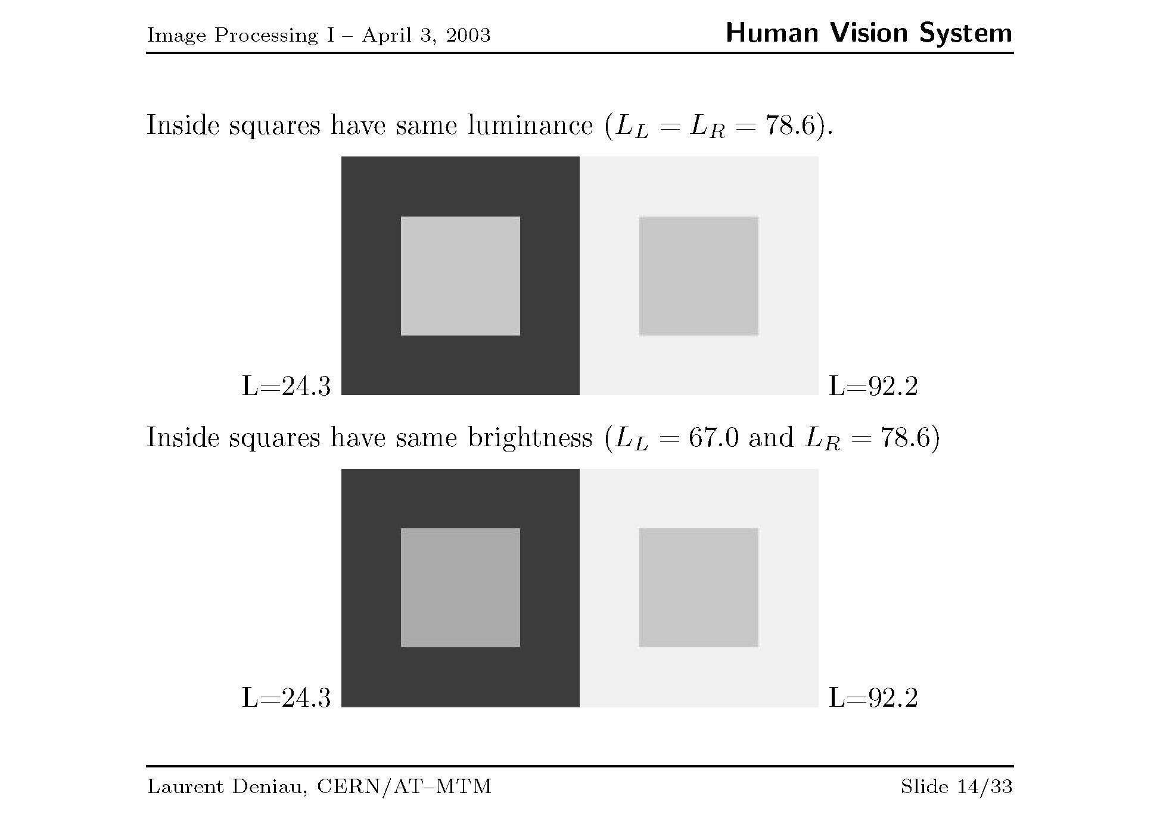
Dr. M. S. Uddin, CSE Dept, JU

Slide 23
Acknowledgement
Prof. Dr. Mohammad Shorif Uddin
Dept. of CSE
Jahangirnagar University

Slide 24

THANKS…

